Slide 1
Co-op101 – Week 1
Welcome and Expectations
Brittany Root, M.Ed, PHR
Assistant Teaching Professor
Steinbright Career Development Center
Pronouns: she/her/hers
bhr26@drexel.edu

Slide 2
Brittany Root, M.Ed, PHR
Assistant Teaching Professor
Steinbright Career Development Center
Pronouns: she/her/hers
bhr26@drexel.edu
Email is a great way to reach me with questions!
Email me if you want to schedule virtual appointments as necessary

Slide 3





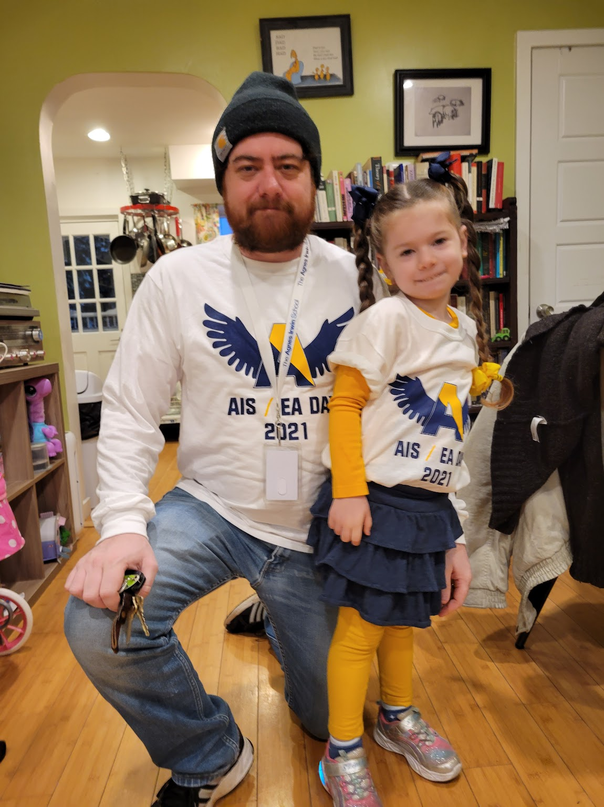

Slide 4


Ice Breaker
What was your 1st job?

Slide 5

Class Requirements – Coop 101 Required-1 Credit Course
Attendance: 40% of your grade
Co-op Resume: 30% of your grade
Assignments (3): 30% of your grade
You Must Pass Co-op 101 to move on to your job search!
Don’t worry-Not the case for this class ☺!!
Notes:
This course has been developed to provide you with the tools necessary to be successful in the Cooperative Education program at Drexel University. Coop 101 serves as a prerequisite for participation in the coop program.
There are 3 main requirements for this course.
Attendance- Attendance is 40% of your grade, so you must attend class! Each class is worth 4 points or 4% of your overall grade.
Resume- You must complete your Coop resume by week 4 of the course using the Steinbright resume development (template) tool. Guidelines, samples and tutorials will be made available through the course and on the Learn site in weekly folders.
Assignments-You will have three assignments due throughout the term. Each assignment is worth 10 points or 10% of your grade.
Your Co-op resume as completed for this course is not intended to be the ‘be all, end all resume.’ It is a starting point, intended to be sure you understand good content and basic, professional formatting for this stage of your career.

Slide 6
Attendance (40% of Your Grade)
Workplace Expectations
Each class is worth 4 points or 4% of your overall grade
Missing Class: Must “call in”/contact me IN ADVANCE and request to be given an alternative written assignment to earn points for that class
Number of alternative assignments granted will be limited
Point deduction if late for class

Slide 7
Co-op Resume: 30% of your grade
Due completed through/uploaded to Career Services tab on DrexelOne
This assignment will not be submitted through Blackboard!

Slide 8
Assignments (3): 30% of your grade
Use ES&P Archives to Identify a target job description
Create a LinkedIn profile
Article or Video resource and paragraph reflection

Slide 9
Will I get an A in COOP 101?
Complete your work on time!
5 Things you Have to do
Come to every class
Resume
3 Assignments
Track your grade on BbLearn

Slide 10
Can I submit my COOP 101 assignments late?
Assignments due dates are included in the course outline chart on Syllabus
After the due date and time (start of class period for most assignments), assignment is late
Late class assignments will only be eligible half credit max (5 out of 10 points) and can only be submitted within one week of the due date and time. Assignments submitted more than one week late will receive zero points.

Slide 11
Bblearn Overview
Review of Class Topics and Timeline

Slide 12

Each week we will discuss a workplace success tip!
Workplace Tip: Be Aware of How you Present Yourself

Slide 13
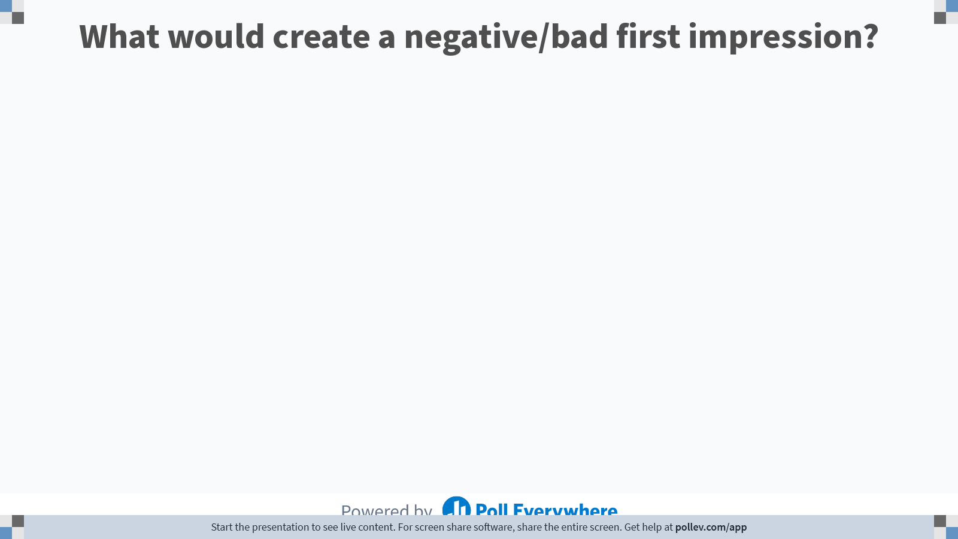
Notes:
Poll Title: Do not modify the notes in this section to avoid tampering with the Poll Everywhere activity. More info at polleverywhere.com/support What would create a negative/bad first impression? https://www.polleverywhere.com/free_text_polls/88ef97VMvBXSmmUWIQoTE

Slide 14
Make a Great First Impression
When/how will your first impression be made? Email, Video or In-person?
Greeting – in the ‘Age of Covid’?
Small Talk
Wardrobe – When in doubt, choose the more formal attire, Consider Industry
Confidence (smile, sit up straight, own your strengths, ask for assistance & advice)
Do your homework about industry and company. Register for ‘Handshake’ platform through Drexel One account, read about companies and reach out to students who have worked there

Slide 15

Interview Question: Why did you choose Drexel?

Slide 16

Notes:
Poll Title: Do not modify the notes in this section to avoid tampering with the Poll Everywhere activity. More info at polleverywhere.com/support What Should you NOT Say when responding to Why You Chose Drexel?! https://www.polleverywhere.com/free_text_polls/vO5VyOXmBIuskvgFj1p7S

Slide 17
Interview Question: Why did you choose Drexel?
May not get asked this question directly-could be an important part of a “tell me about yourself” response
Reflect: What do you think the employer is hoping to hear in your response?
If co-op is the reason, it’s important to say that!!
Length of response (too short versus too long)
Consider: What will the employer think the response says about you?
Notes:
Your answer should be multifaceted. Avoid brief, one word response. Choose at least 2 reasons you chose Drexel and answer the WHY for each reason you outline. Appropriate to talk for 30 seconds to a minute and a half or two minute. You don’t want to go into an extensive monologue, but you also need to provide meaningful information.
Some great ideas to discuss: Co-op experience/opportunity to gain experience, quality of academic program, dynamic location (Philadelphia)

Slide 18
Add Assignment Due Dates to Your Calendar!
1. Pair Up
2. Pull Up Syllabus from Bblearn
3. Find due dates for resume and 3 assignments
4. Add to your Outlook Calendar
5. Set up Reminders!
In-Class Work

Slide 19
Before Next Week:
Complete the Week One survey
Access it on Drexel Learn
*Not an assignment for points, just a request

